Slide 1
Qualities of an Effective Team Player
Prepared by Dr. T. Sunand Emmanuel

Slide 2
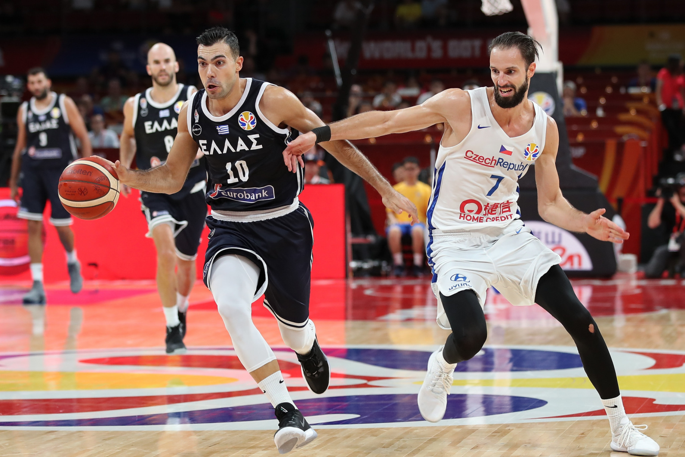

Slide 3
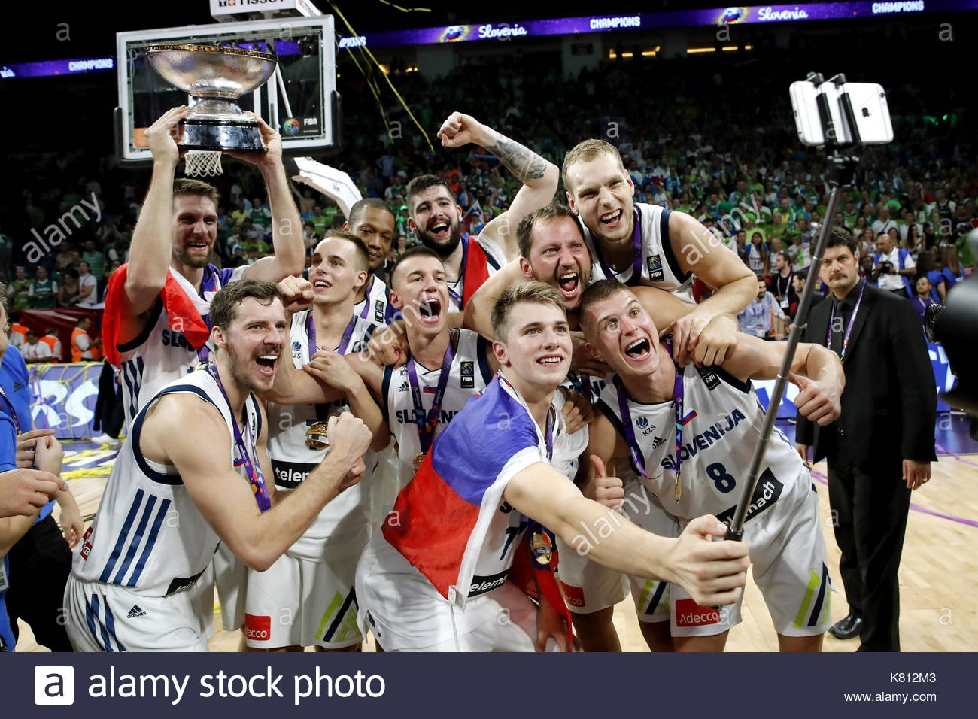

Slide 4
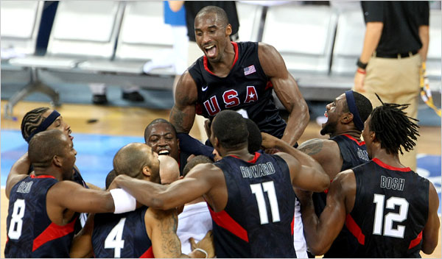

Slide 5
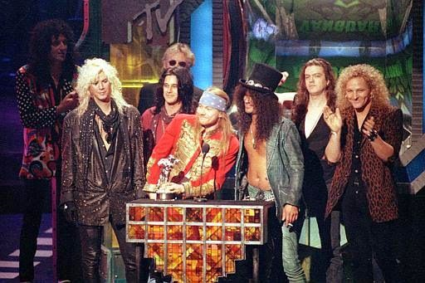
Guns and Roses team

Slide 6
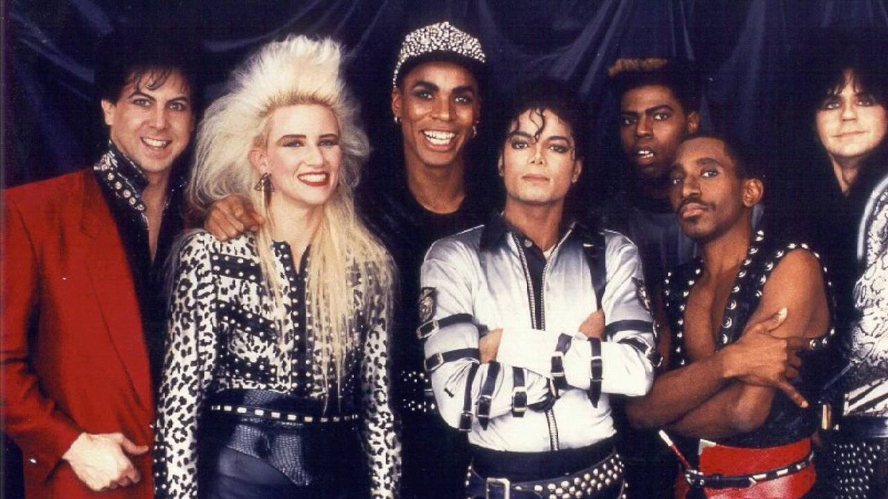
Jennifer Batten, Michael Jackson, and others….

Slide 7
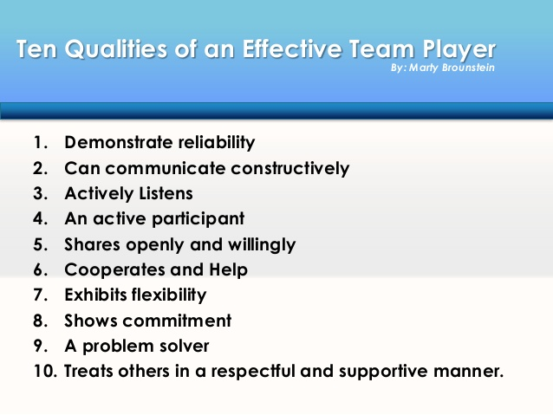

Slide 8
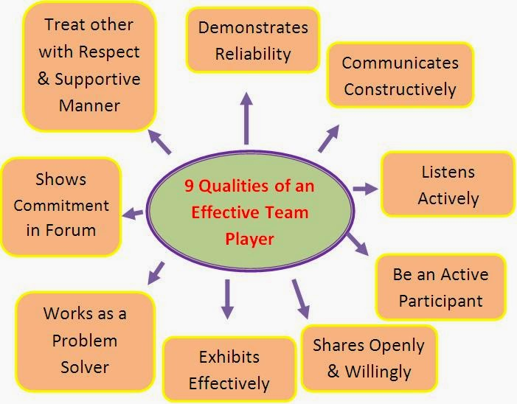

Slide 9
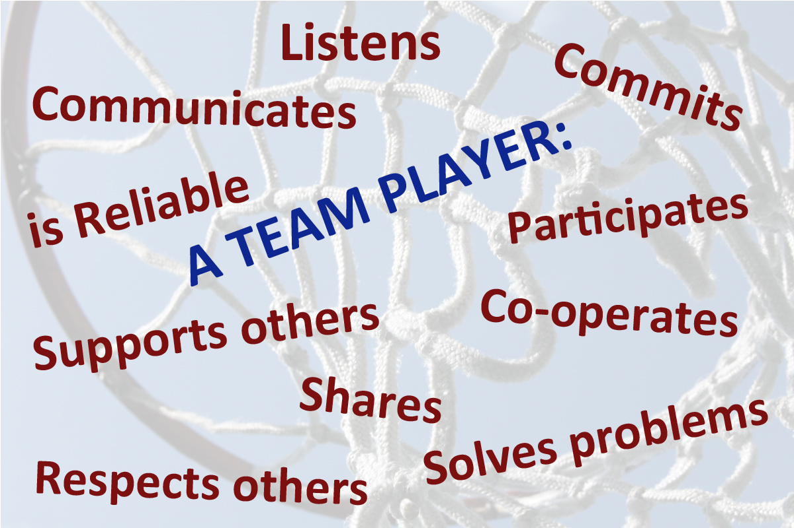

Slide 10
If you were choosing team members for a business team in your organization, who would the best team players be?
Assuming that people have the right technical skills for the work to be done, what other factors would you use to select your team members?
Teams need strong team players to perform well. But what defines such people?

Slide 11
Demonstrates reliability
You can count on a reliable team member who gets work done and does his fair share to work hard and meet commitments. He or she follows through on assignments. Consistency is key. You can count on him or her to deliver good performance all the time, not just some of the time.
Communicates constructively. Teams need people who speak up and express their thoughts and ideas clearly, directly, honestly, and with respect for others and for the work of the team. That’s what it means to communicate constructively. Such a team member does not shy away from making a point but makes it in the best way possible — in a positive, confident, and respectful manner

Slide 12
Listens actively:
Good listeners are essential for teams to function effectively. Teams need team players who can absorb, understand, and consider ideas and points of view from other people without debating and arguing every point. Such a team member also can receive criticism without reacting defensively. Most important, for effective communication and problem solving, team members need the discipline to listen first and speak second so that meaningful dialogue results.

Slide 13
Functions as an active participant:
Good team players are active participants. They come prepared for team meetings and listen and speak up in discussions. They’re fully engaged in the work of the team and do not sit passively on the sidelines. Team members who function as active participants take the initiative to help make things happen, and they volunteer for assignments. Their whole approach is can-do: “What contribution can I make to help the team achieve success?”

Slide 14
Shares openly and willingly:
Good team players share. They’re willing to share information, knowledge, and experience. They take the initiative to keep other team members informed. Much of the communication within teams takes place informally. Beyond discussion at organized meetings, team members need to feel comfortable talking with one another and passing along important news and information day-to-day. Good team players are active in this informal sharing.

Slide 15
They keep other team members in the loop with information and expertise that helps get the job done and prevents surprises. Cooperates and pitches in to help Cooperation is the act of working with others and acting together to accomplish a job. Effective team players work this way by second nature. Good team players, despite differences they may have with other team members concerning style and perspective, figure out ways to work together to solve problems and get work done. They respond to requests for assistance and take the initiative to offer help.

Slide 16
Exhibits flexibility:
Teams often deal with changing conditions — and often create changes themselves. Good team players roll with the punches; they adapt to ever-changing situations. They don’t complain or get stressed out because something new is being tried or some new direction is being set. In addition, a flexible team member can consider different points of views and compromise when needed. He or she doesn’t hold rigidly to a point of view and argue it to death, especially when the team needs to move forward to make a decision or get something done. Strong team players are firm in their thoughts yet open to what others have to offer — flexibility at its best.

Slide 17
Shows commitment to the team:
Strong team players care about their work, the team, and the team’s work. They show up every day with this care and commitment up front. They want to give a good effort, and they want other team members to do the same.

Slide 18
Works as a problem-solver:
Teams, of course, deal with problems. Sometimes, it appears, that’s the whole reason why a team is created — to address problems. Good team players are willing to deal with all kinds of problems in a solutions-oriented manner. They’re problem-solvers, not problem-dwellers, problem-blamers, or problem-avoiders. They don’t simply rehash a problem the way problem-dwellers do. They don’t look for others to fault, as the blamers do. And they don’t put off dealing with issues, the way avoiders do.
Team players get problems out in the open for discussion and then collaborate with others to find solutions and form action plans.

Slide 19
Treats others in a respectful and supportive manner:
Team players treat fellow team members with courtesy and consideration — not just some of the time but consistently. In addition, they show understanding and the appropriate support of other team members to help get the job done. They don’t place conditions on when they’ll provide assistance, when they’ll choose to listen, and when they’ll share information. Good team players also have a sense of humor and know how to have fun (and all teams can use a bit of both), but they don’t have fun at someone else’s expense. Quite simply, effective team players deal with other people in a professional manner.

Slide 20
References
Communication Skills and Soft Skills: An Integrated Approach eBook: Suresh Kumar, E., Sreehari, P., Savithri, J

